Slide 1

Machine Learning Algorithms Ensemble Learning
Raghu Prasad Konandur
9845547471
www.kaushalya.tech
raghuprasadkonandur@kaushalya.tech

Slide 2
Introduction
Raghu Prasad – BE, MS
Total of 27 years of experience
7 years as a lecturer in an Engineering College
20 Years into IT
Worked with companies like CISCO,CSC,ICICI,First Apex – NTT Data
Currently into Corporate training and consultancy
Worked with corporates and public sector
Service Offerings – In person/On-line/Corporate/Academic Institutes
Consultancy – Consultant to vendor of Atal Tinkering Lab/ECIL-ECIT, Incarnus – Healthcare Service Provider
Technologies – Java,Python,Web technologies,Java Script technologies (MEAN stack),IOT,Test Automation,Machine Learning,Artificial Intelligence,ERP,.NET
Customers – Philips,L & T,NextGen,Incarnus,Aspire system,BGS-IT,Sindhi College,Malnad Enginering College,S B College of Management, REVA University,Nagarjuna Engineering College,Dayanand Sagar University,Acharya Institute of Technology,NIE Mysore,NIT-Imphal,etc

Slide 3
Topics
Ensemble Learning
Boosting
Bagging
Random Forest

Slide 4
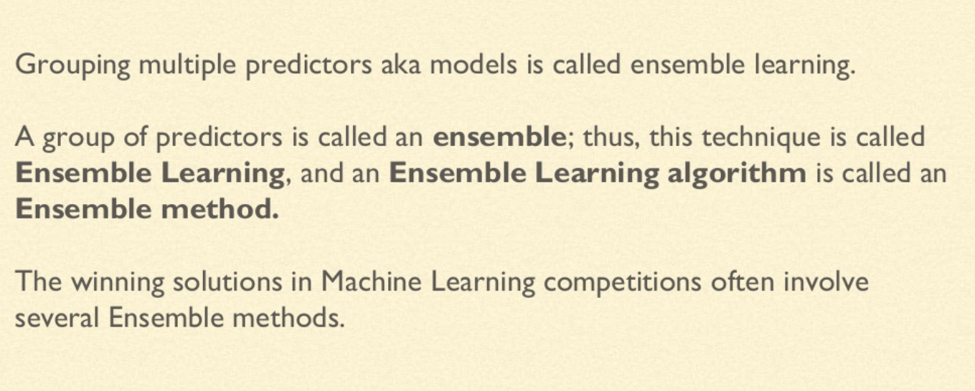
Ensemble Learning

Slide 5
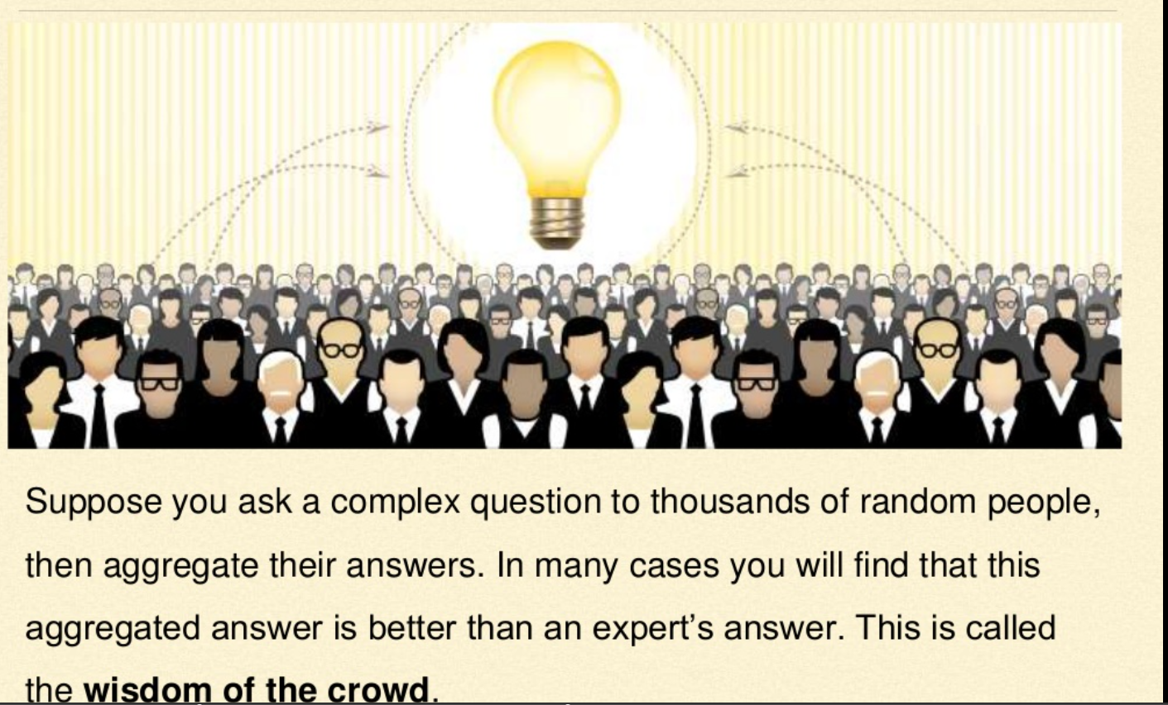
Ensemble Learning

Slide 6
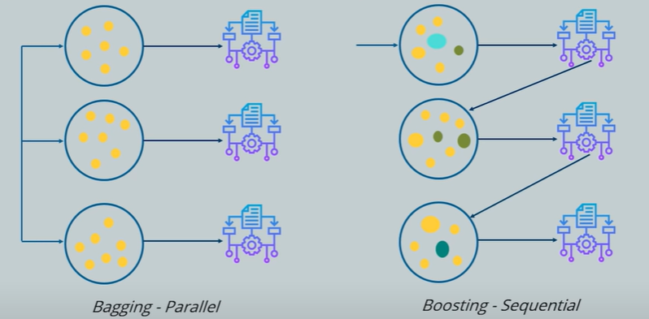
Ensemble Learning
Ensemble learning is a method that is used to enhance the performance of Machine Learning by combining several learners. When compared to a single model, this type of learning builds model with improved efficiency and accuracy. There are two types of ensemble learning namely bagging and boosting.

Slide 7
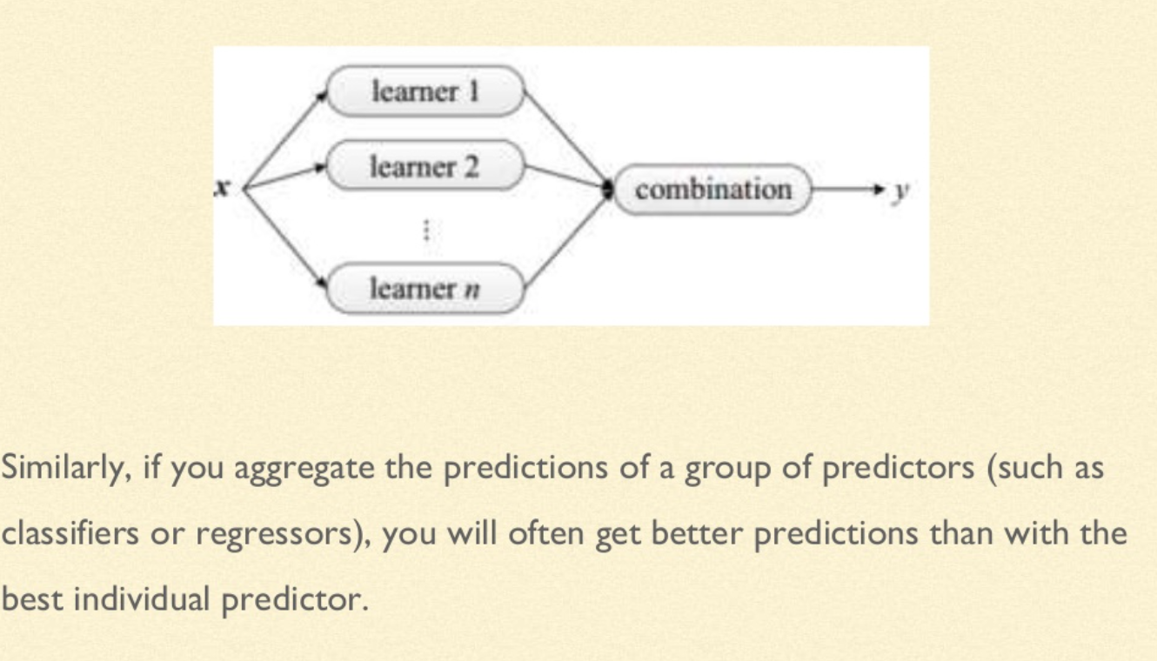
Ensemble Learning

Slide 8
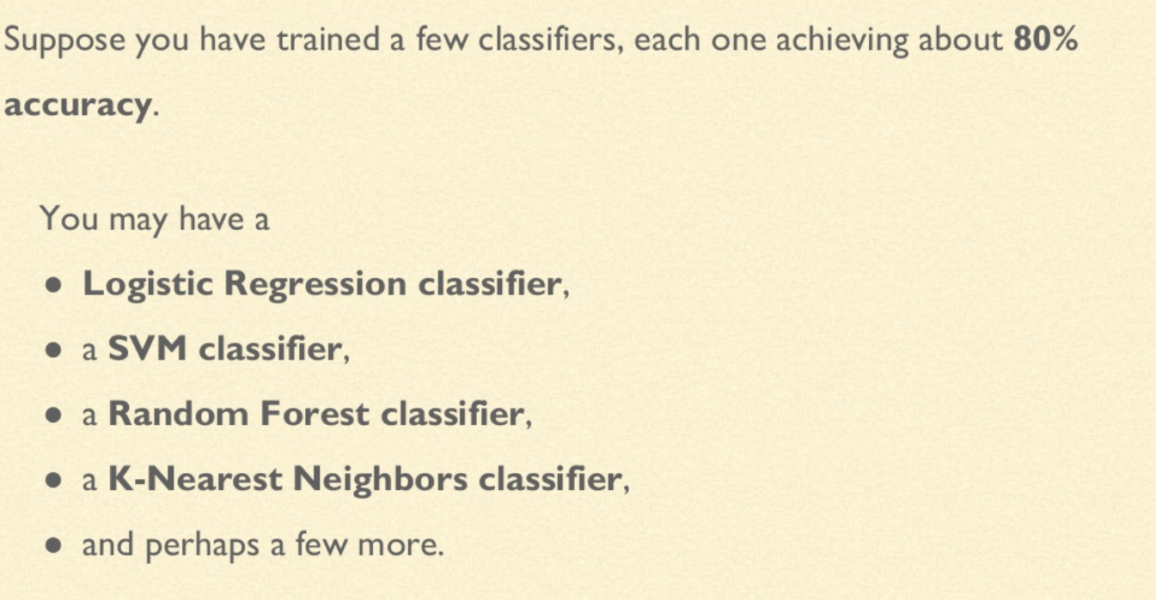
Voting Classifiers

Slide 9
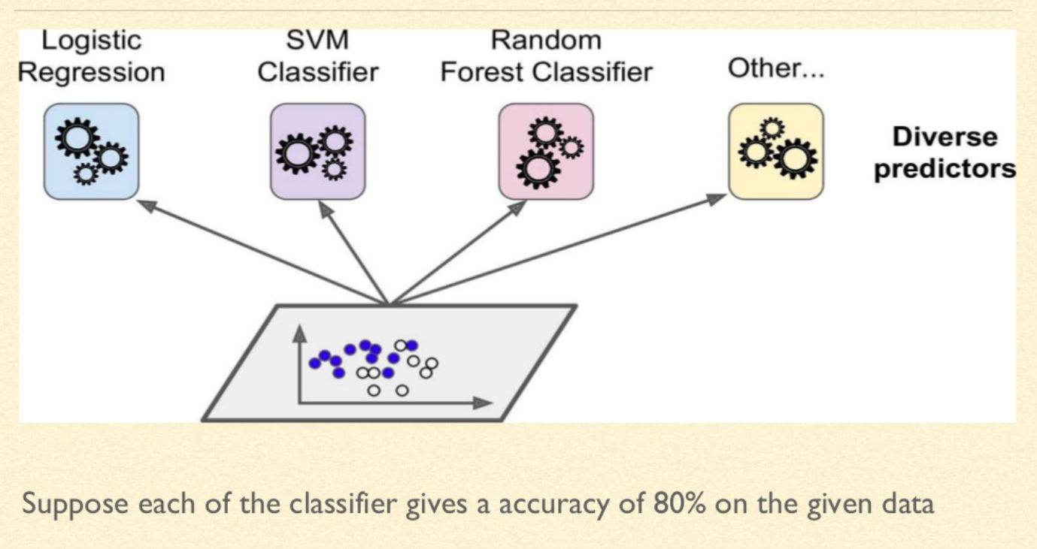
Voting Classifiers

Slide 10
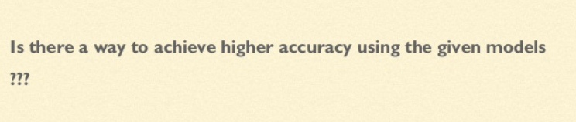
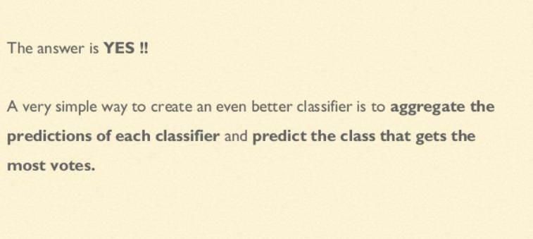
Voting Classifiers

Slide 11
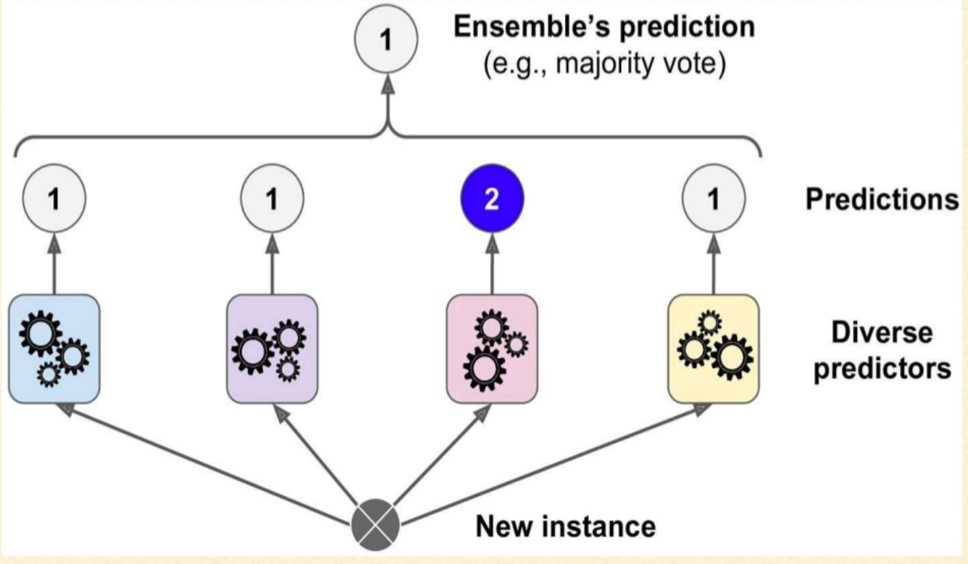
Voting Classifiers

Slide 12
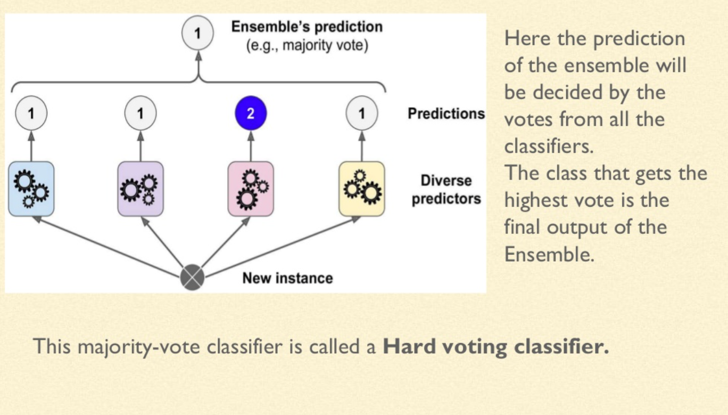
Voting Classifiers

Slide 13
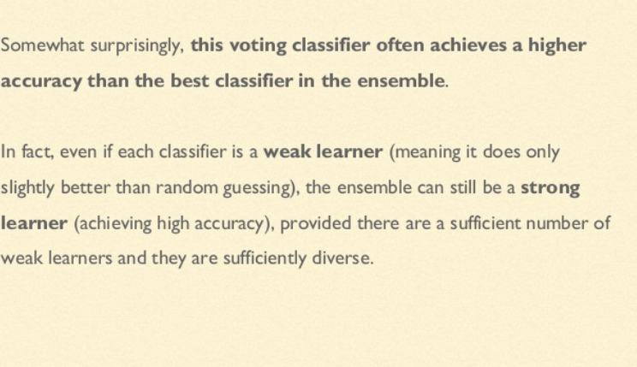
Voting Classifiers

Slide 14
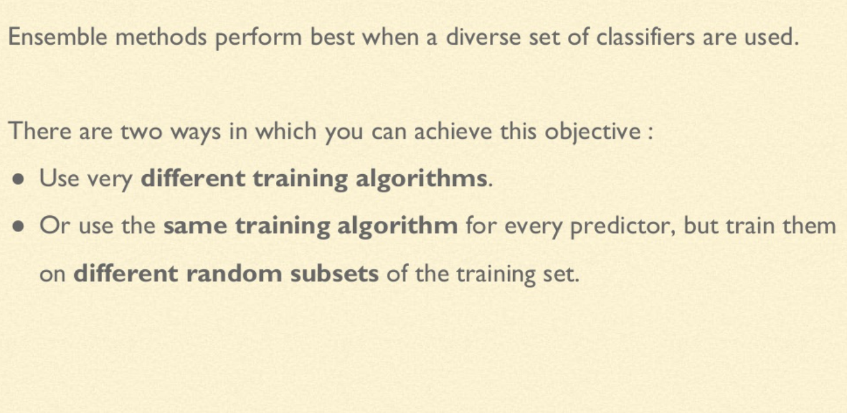
Bagging and Pasting

Slide 15
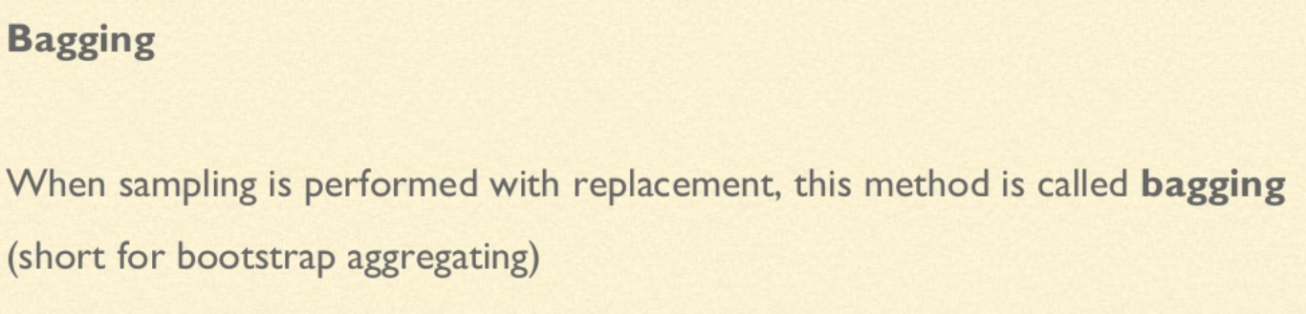
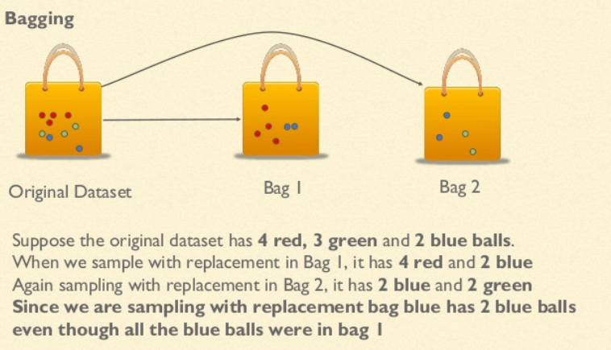
Bagging and Pasting

Slide 16
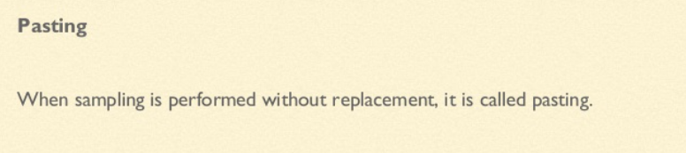
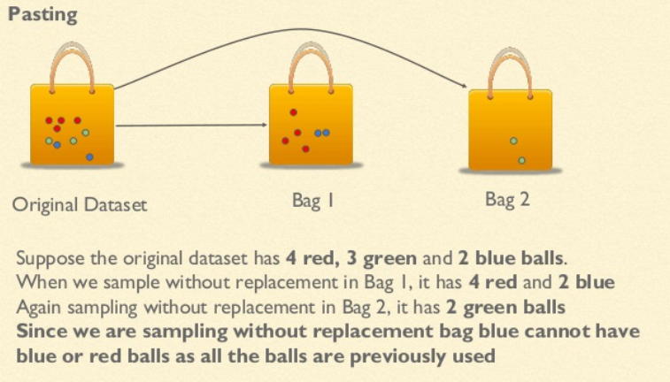
Bagging and Pasting

Slide 17
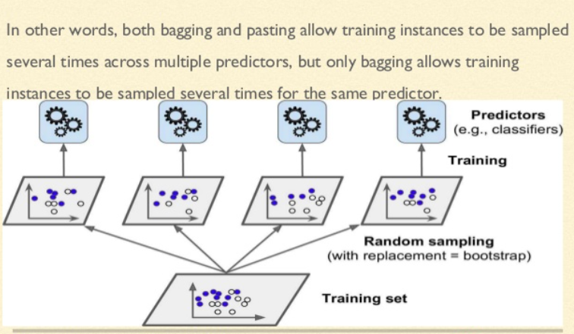
Bagging and Pasting

Slide 18
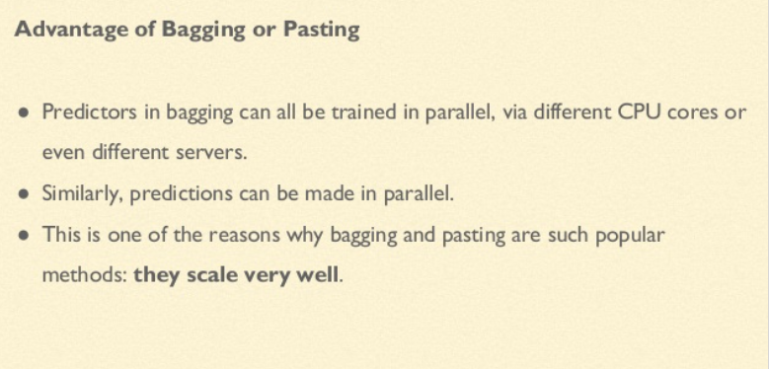
Bagging and Pasting

Slide 19
Random Forest
Random forest is a supervised learning algorithm. The "forest" it builds, is an ensemble of decision trees, usually trained with the “bagging” method. The general idea of the bagging method is that a combination of learning models increases the overall result.
Random forest builds multiple decision trees and merges them together to get a more accurate and stable prediction.
One big advantage of random forest is that it can be used for both classification and regression problems, which form the majority of current machine learning systems.

Slide 20
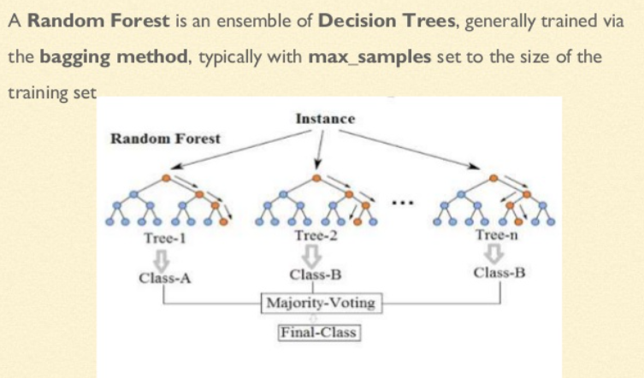
Random Forest

Slide 21
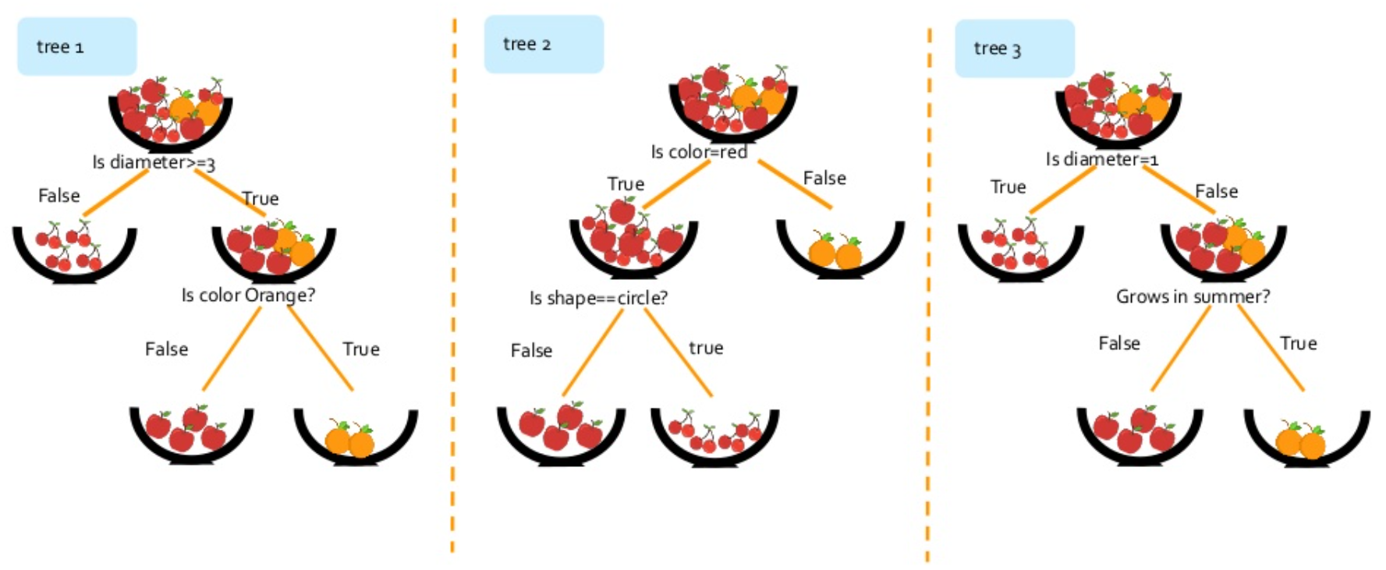
How does a Random Forest work ?

Slide 22
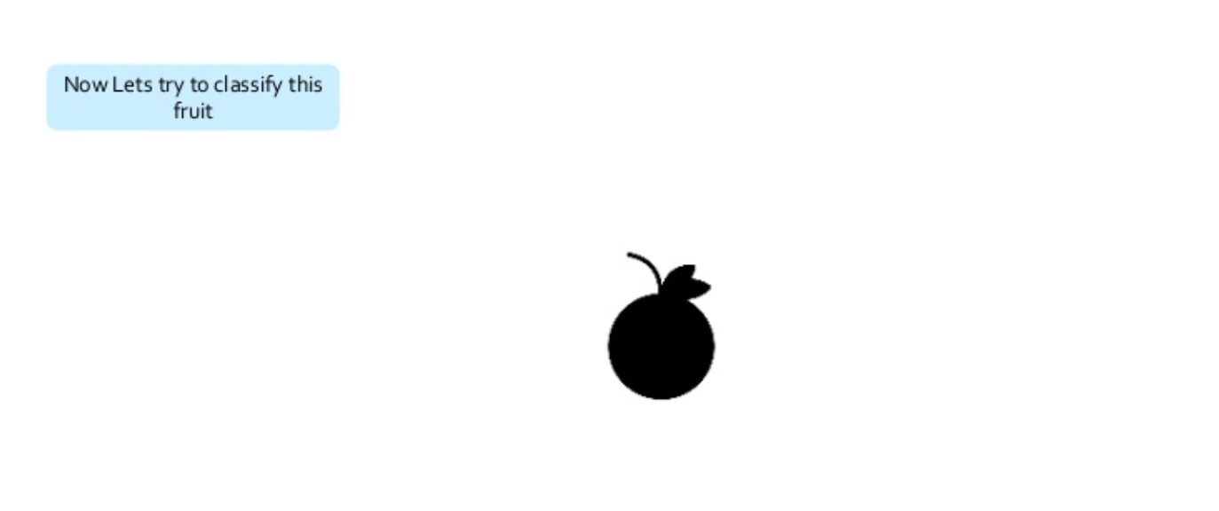
How does a Random Forest work ?

Slide 23
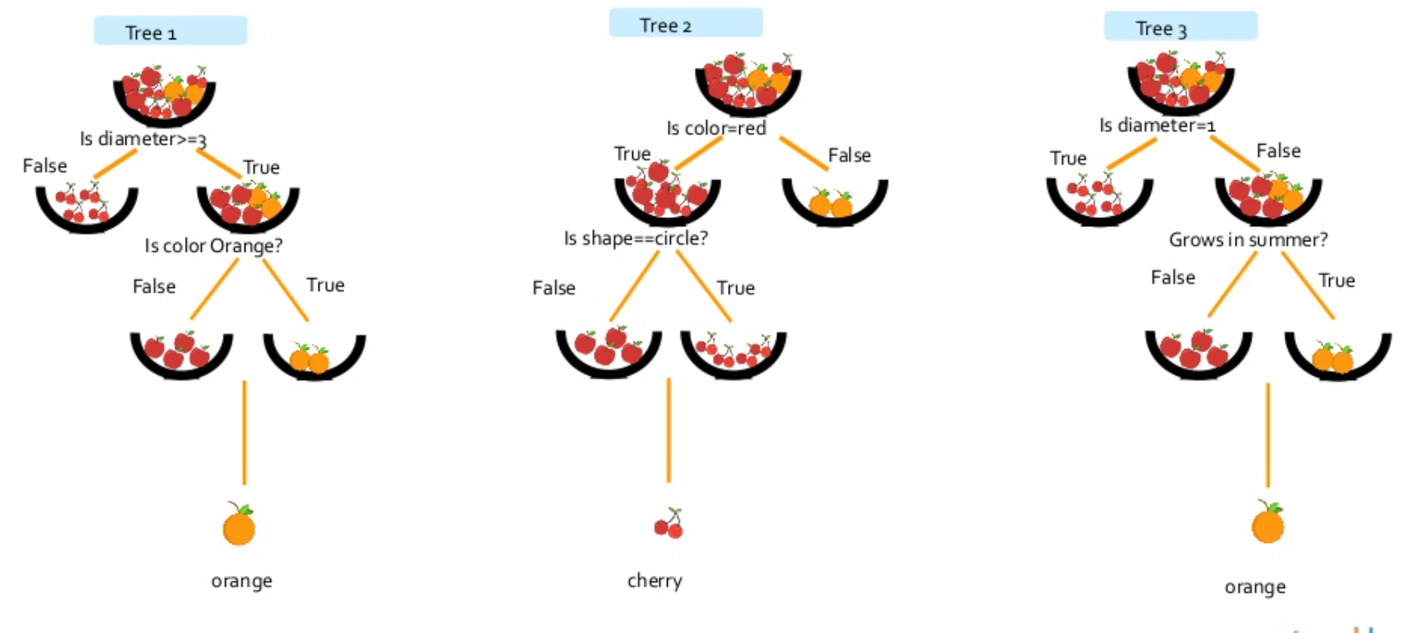
How does a Random Forest work ?

Slide 24
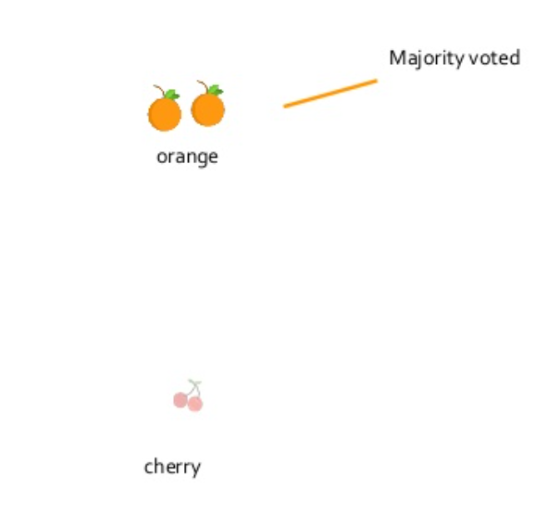
How does a Random Forest work ?

Slide 25
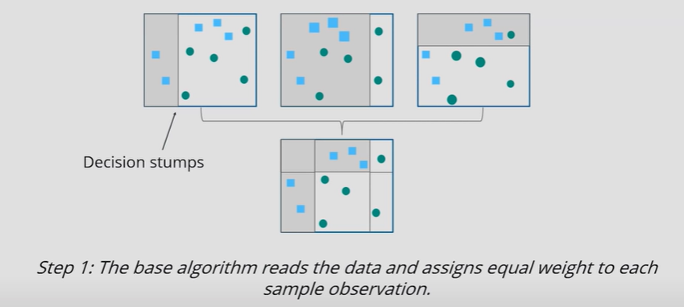
Boosting
The basic principle behind the working of the boosting algorithm is to generate multiple week learners and combine their predictions to form one strong rule.
Step 1

Slide 26
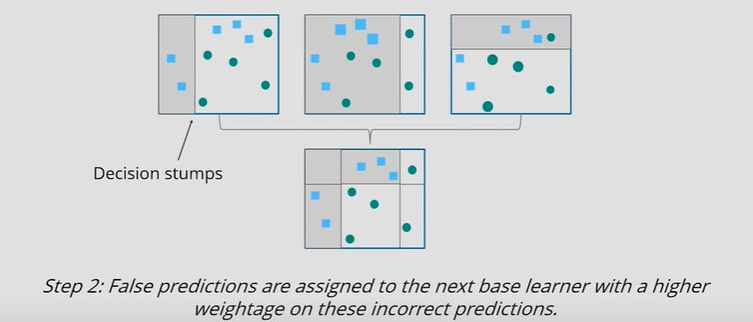
Boosting
Step 2

Slide 27
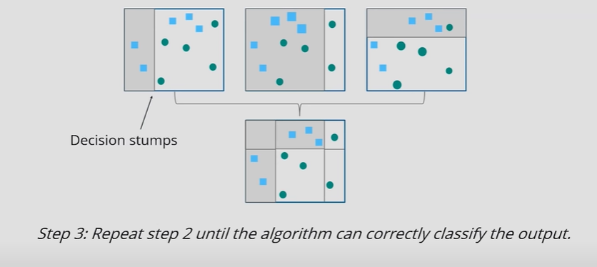
Boosting
Step 3

Slide 28
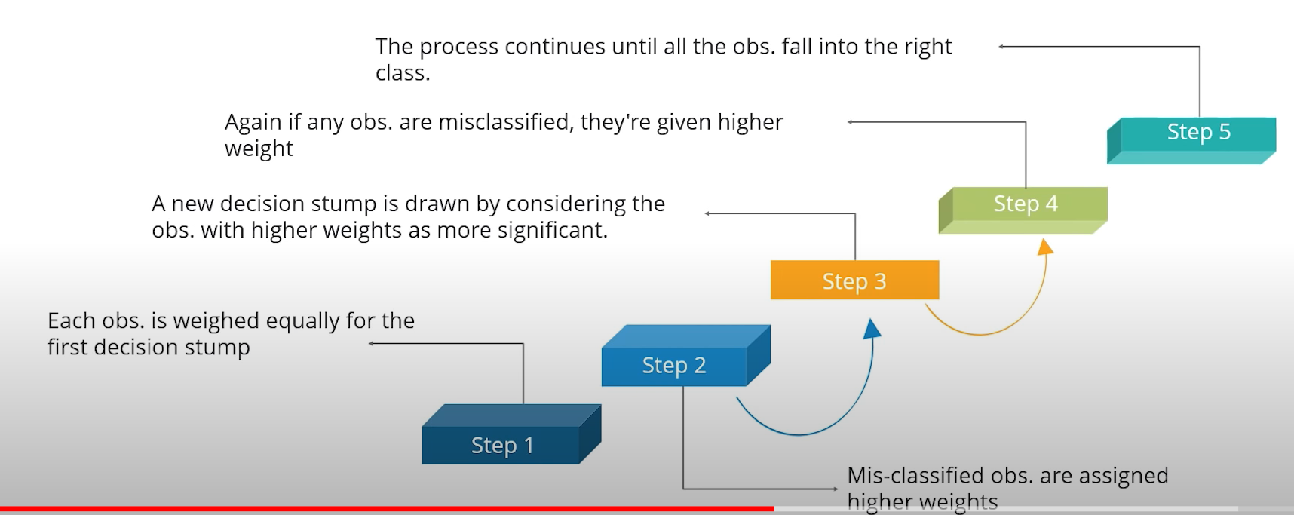
Adaptive Boosting

Slide 29
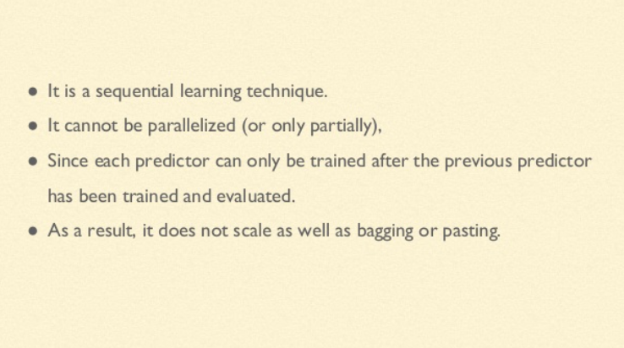
Ada Boost-Drawback

Slide 30
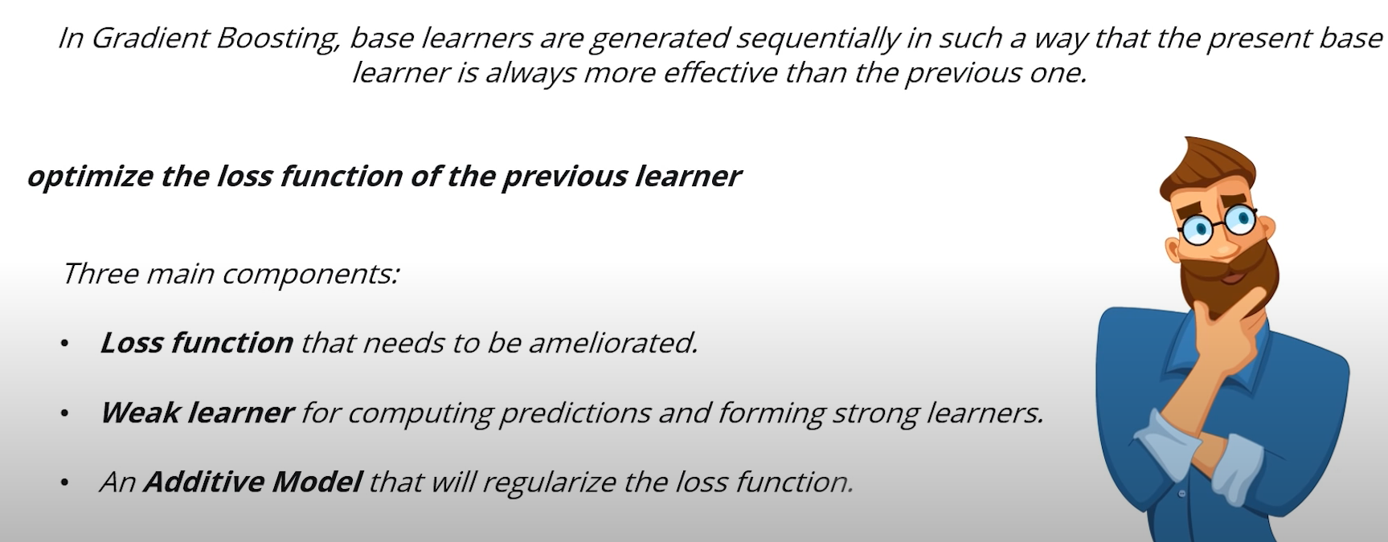
Gradient Boosting

Slide 31
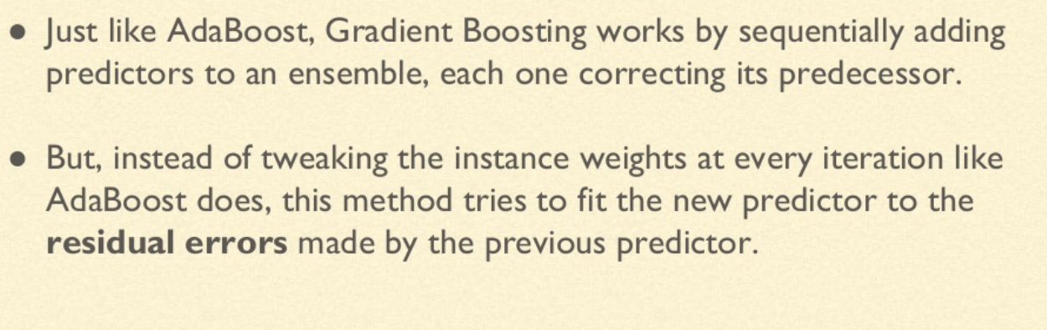
Gradient Boosting

Slide 32
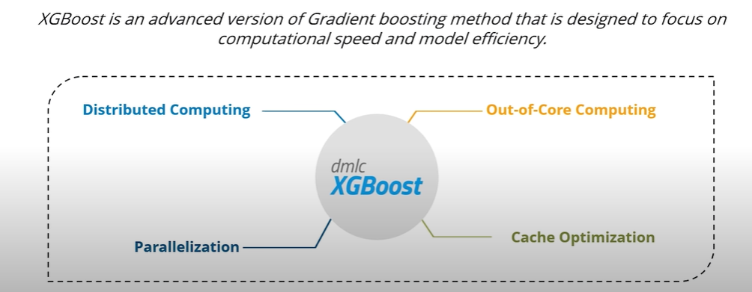
XG (eXtreme) Boosting

Slide 33
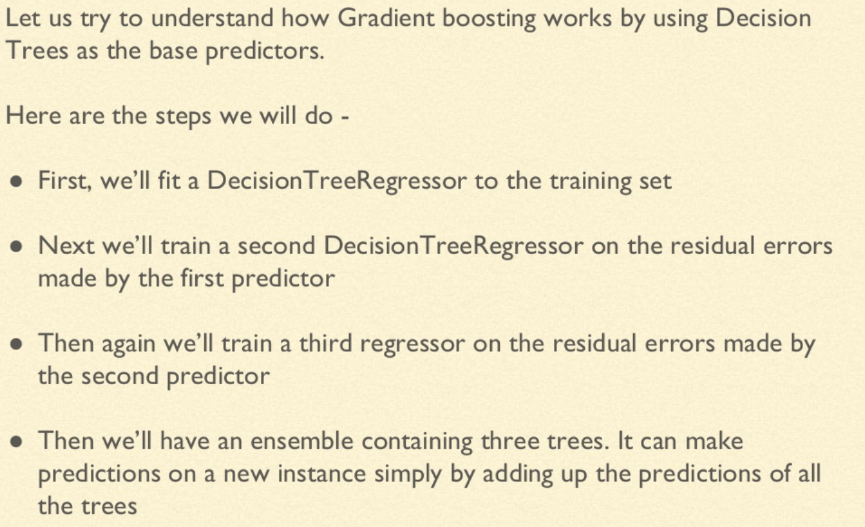
Gradient Boosting

Slide 34
Hands-on session
Random Forest
Bagging and Boosting

Slide 35
References
https://www.skillbasics.com/
https://www.slideshare.net/Simplilearn/random-forest-algorithm-random-forest-explained-random-forest-in-machine-learning-simplilearn-91647398

Slide 36
Thank You
Raghu Prasad Konandur
9845547471
www.kaushalya.tech
raghuprasadkonandur@kaushalya.tech

